Slide 1
The Rise of China
Alan V. Deardorff
For panel hosted by
Michigan Journal of International Affairs
March 22, 2017

Slide 2
Some Data on China
China’s Economy
China’s International Initiatives
China’s Rankings

Slide 3
China’s Economy
GDP
  Is about 2/3 of US GDP in dollars
    Expected to surpass US in less than 10 years

Slide 4
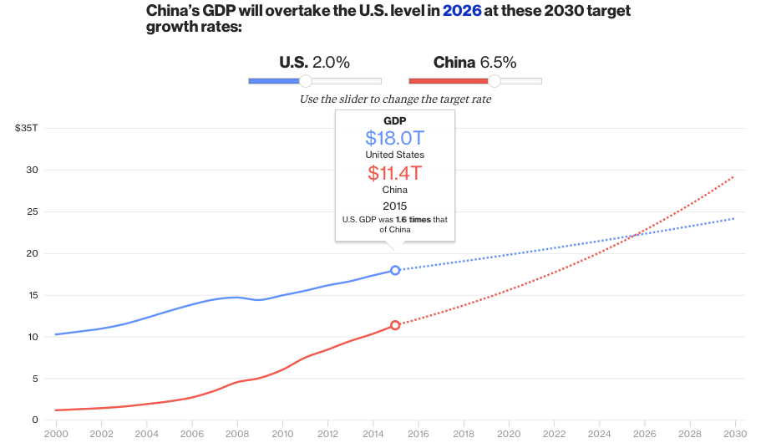
Notes:
https://www.bloomberg.com/graphics/2016-us-vs-china-economy/

Slide 5
China’s Economy
GDP
  Is about 2/3 of US GDP in dollars
    Expected to surpass US in less than 10 years
  In real terms (PPP)
    China: $21.27 trillion (2016 est, per CIA)
    US: $18.56 trillion (2015 est, per CIA)
  In real terms (Big Macs, per Economist)
    China: 3.9 trillion burgers
    US: ~3.7 trillion burgers

Slide 6
China’s Economy
GDP per capita (at nominal exchange rates)
  Still less than ½ the OECD average
  About ¼ the US
  But has grown dramatically since 1980

Slide 7
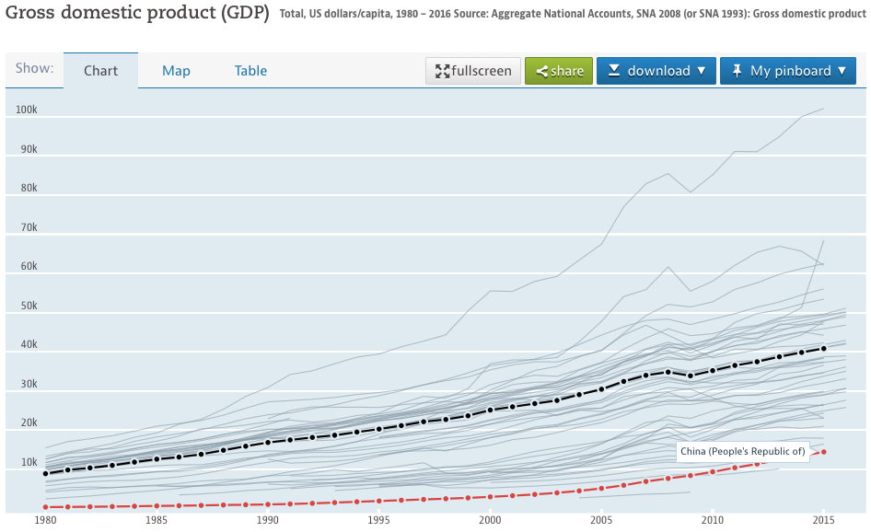

Luxembourg
Ireland
Norway
Switzerland
United States
OECD
China
Notes:
https://data.oecd.org/gdp/gross-domestic-product-gdp.htm

Slide 8
China’s Economy
Other China data
  Spending on R&D
  Military Expenditure
  Trade
  Exchange rate
  International reserves

Slide 9
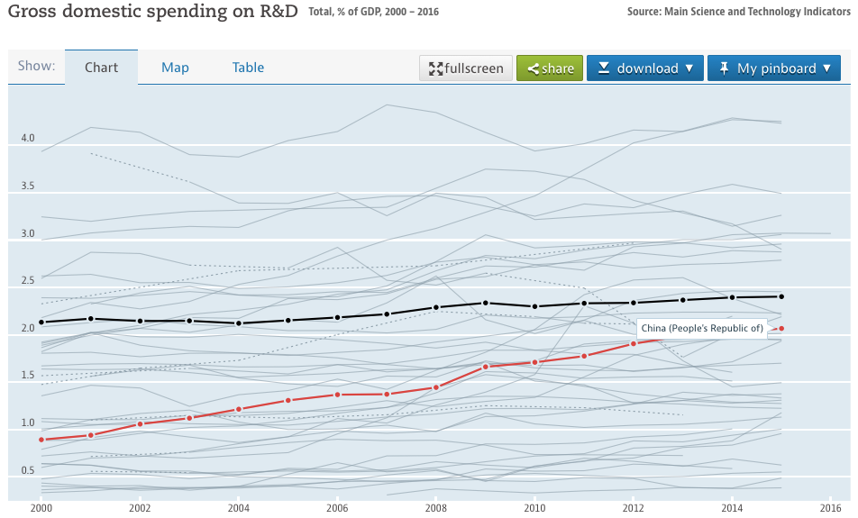
R&D
OECD
China
Notes:
https://data.oecd.org/rd/gross-domestic-spending-on-r-d.htm

Slide 10
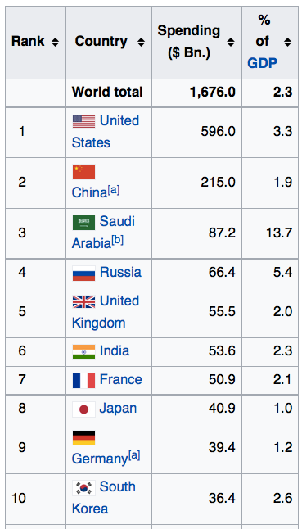
Military Expenditure 2015
Stockholm International Peace Research Institute
(via Wikipedia)
Notes:
https://en.wikipedia.org/wiki/List_of_countries_by_military_expenditures

Slide 11
Stockholm International Peace Research Institute

Slide 12

Who Trades the Most?
($ b. & % share, 2015)
Exporters |  |  | Importers
 | Value | Share |  | Value | Share
China | 2275 | 13.8 | US | 2308 | 13.8
US | 1505 | 9.1 | China | 1682 | 10.1
Germany | 1329 | 8.1 | Germany | 1050 | 6.3
Japan | 625 | 3.8 | Japan | 648 | 3.9
Netherlands | 567 | 3.4 | UK | 626 | 3.7
World | 16,482 | 100.0 | World | 16,725 | 100.0
Source: WTO, World Trade Statistical Review, 2016, Table A6
Notes:
Source: https://www.wto.org/english/res_e/statis_e/wts2016_e/wts16_chap9_e.htm
Folder: WTO Trade Statistics

Slide 13
Who Trades the Most?
(Excluding intra-EU-28)
($ b. & % share, 2015)
+ = 3813
+ = 3957
Exporters |  |  | Importers
 | Value | Share |  | Value | Share
China | 2275 | 17.4 | US | 2308 | 17.3
EU-28* | 1985 | 15.2 | EU-28* | 1914 | 14.4
US | 1505 | 11.5 | China | 1682 | 12.6
Japan | 625 | 4.8 | Japan | 648 | 4.9
Korea, S. | 527 | 4.0 | Hng Kng | 559 | 4.2
World | 13,080 | 100.0 | World | 13,323 | 100.0
+ = 3899
*EU external only
Source: WTO, World Trade Statistical Review, 2016, Table A7
Notes:
Source: https://www.wto.org/english/res_e/statis_e/wts2016_e/wts16_chap9_e.htm
Folder: WTO Trade Statistics

Slide 14
China’s Exchange Rate, US$/Yuan, 2000-2016
The yuan reached its peak in 2013, and began to fall in 2015
IMF: International Financial Statistics
Notes:
China currency.xlsx
From IMF, IFS

Slide 15
Reserves have mostly risen, to over $4 trillion,
But lately they have fallen, even below $3 trillion
IMF: International Financial Statistics
Notes:
See China Currency.xlsx

Slide 16
Some Data on China
China’s Economy
China’s International Initiatives
China’s Rankings

Slide 17
China’s International Initiatives
RCEP
  Regional Comprehensive Economic Partnership
  Free Trade Agreement, being negotiated
    16 countries
      ASEAN 10
      China, India, Japan, S. Korea, Australia, New Zealand

Slide 18
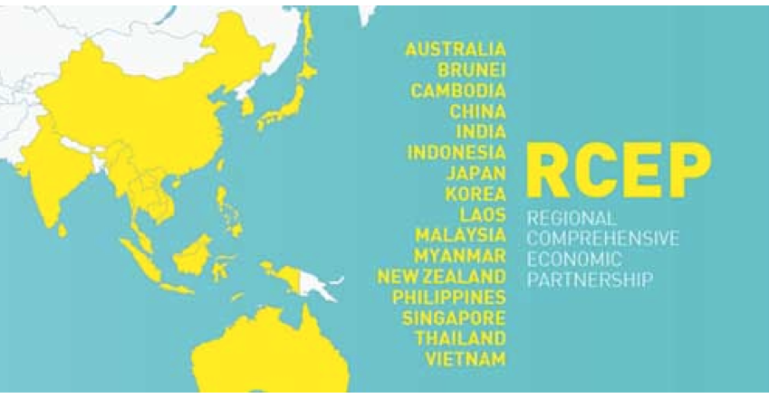
Notes:
http://www.civilsdaily.com/story/regional-comprehensive-economic-partnership-rcep/

Slide 19
China’s International Initiatives
One Belt, One Road
  Initiative begun 2013 to expand infrastructure for international trade along:
    Land route through Central Asia (One Belt)
    Sea route through Southeast Asia and the Indian Ocean (One Road)
    To Europe

Slide 20
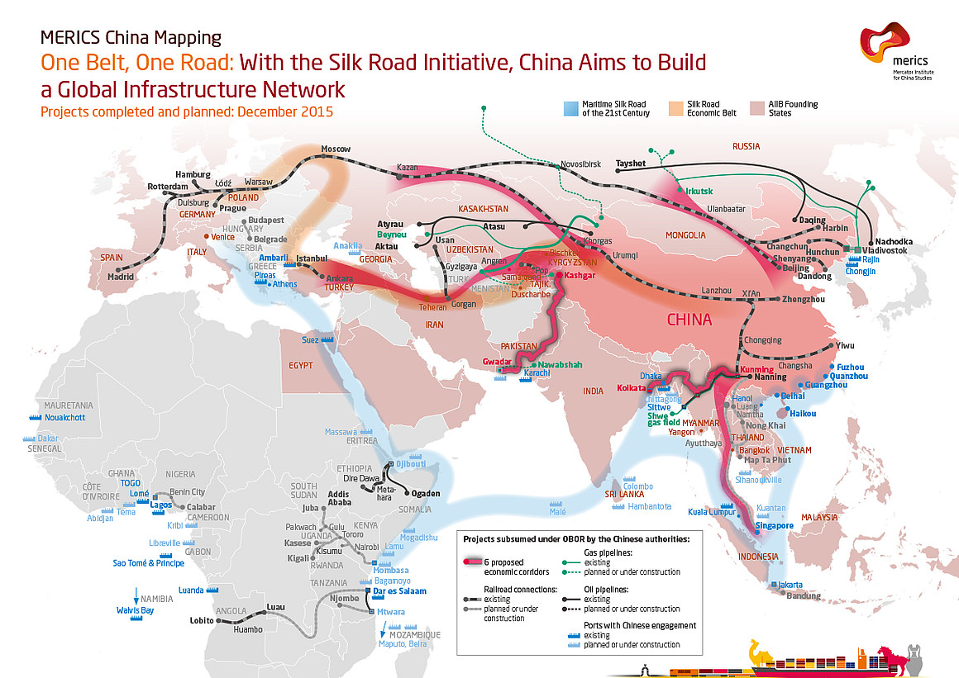
Notes:
https://www.linkedin.com/pulse/chinas-one-belt-road-momentum-going-forward-ruston-bazzarre

Slide 21
China’s International Initiatives
Asian Infrastructure Investment Bank
  Development bank focused on “the development or infrastructure and other productive sectors in Asia”
  Was able to attract 46 founding member countries
  US tried to persuade others not to join but failed

Slide 22
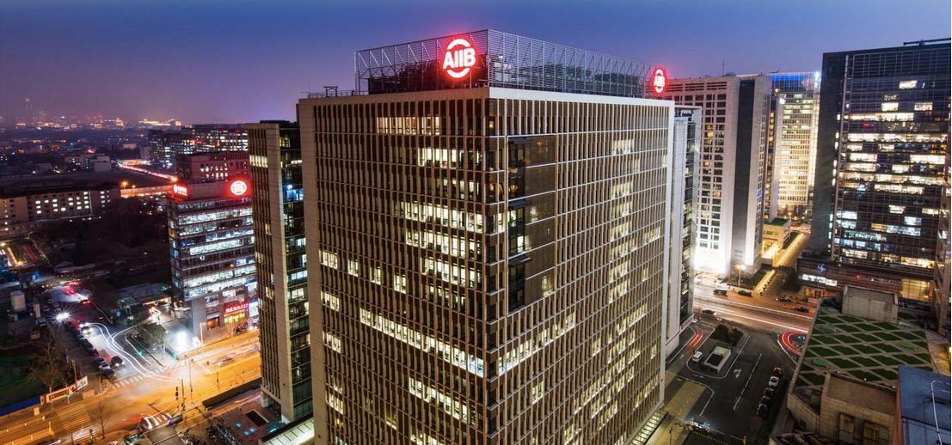
Notes:
https://www.aiib.org/en/about-aiib/index.html

Slide 23
China’s International Initiatives
Taking the lead on Globalization
  President Xi stressed the virtues of free trade at Davos

Slide 24

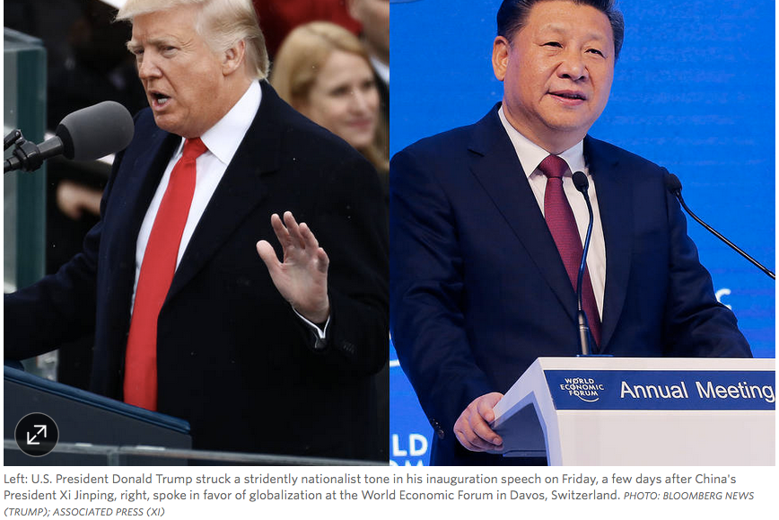
Notes:
https://www.wsj.com/articles/a-u-s-china-role-switch-whos-the-globalist-now-1485250202

Slide 25
Some Data on China
China’s Economy
China’s International Initiatives
China’s Rankings

Slide 26


China’s Rankings
Foreign Direct Investment
  Outward: #11
  Inward: #5
  (US is #2 in both, after EU)

Slide 27

Source: UNCTAD World Investment Report 2013

Slide 28
China’s Rankings
Soft Power
  #28 out of 30
    Below Russia
    Above Czech Republic
    (Top 5 are US, UK, Germany, Canada, France)
Source: Portland
Notes:
http://softpower30.portland-communications.com/ranking/

Slide 29

China’s Rankings
Press Freedom
  #176 out of 180
    Below Vietnam
    Above Syria
  (Top 5 are Finland, Netherlands, Norway, Denmark, New Zealand)
  (US is 41)
Notes:
https://rsf.org/ranking#!/

Slide 30

China’s Rankings
Corruption Perceptions Index
  #100 out of 175
    Below Egypt an others
    Tied with Algeria Suriname
    Above Mexico and others
  (Top 5 are Denmark, New Zealand, Finland, Sweden, and Norway)
  (US is #17)
Notes:
http://www.transparency.org/cpi2014/infographic#compare

Slide 31

China’s Rankings
Human Development Index
  #90 out of 187
    Below Saint Lucia
    Tied with Mongolia and others
    Above Thailand
  (Top 5 are Norway, Australia, Switzerland, Denmark, and Netherlands)
  (US is #8)
Notes:
http://hdr.undp.org/sites/default/files/ranking.pdf

Slide 32

China’s Rankings
Ease of Doing Business
  #78 out of 189
    Below Tunisia
    Above Ukraine
  (Top 5 are New Zealand, Singapore, Denmark, Hong Kong, S. Korea)
  (US is #8)
Notes:
http://www.doingbusiness.org/rankings

Slide 33

China’s Rankings
Best Countries
  #20 out of 80
    Below Spain
    Above Ireland
  (Top 5 are Switzerland, Canada, U.K., Germany, Japan)
  (US is #7)
Notes:
https://www.usnews.com/news/best-countries/overall-full-list

Slide 34

China’s Rankings
Global Competitiveness
  #28 out of 140
    Below Israel
    Above Iceland
  (Top 5 are Switzerland, Singapore, U.S., Germany, Netherlands)
  (US is #3)
Notes:
http://reports.weforum.org/global-competitiveness-report-2015-2016/competitiveness-rankings/

Slide 35

China’s Rankings
Sovereign Wealth Funds by Assets
  #100 China Investment Corporation - $814 b.
  #6 SAFE Investment Company - $474 b.
  #7 Hong Kong Monetary Authority Investment Portfolio - $457 b.
  #10 National Social Security Fund - $295 b.
  (All others in top 10 except Singapore, #8, originate from oil.)
  (#1 is Norway $871 b.)
Source: SWFI
Notes:
http://www.swfinstitute.org/sovereign-wealth-fund-rankings/

Slide 36
Summary
China has
  Surpassed the US, or soon will, in size
  A long way to go to match US in well-being
  Growing influence on the world stage

